Slide 1
New UHF TRx– Weekly meeting
Marco Panetti
Date: 2023/01/25

Slide 2
Current status
Subsystem | Task | Responsible | Status | Priority | Deadline | %done
New UHF | 1. Sending Tharindu-san components | Marco | Export documents in preparation (by Kawano san) | High | As soon as possible | 25%
 | 2. Procurements for TRx Board | Marco | Just received Order from Tharindu | High | As soon as possible | 0%

Slide 3
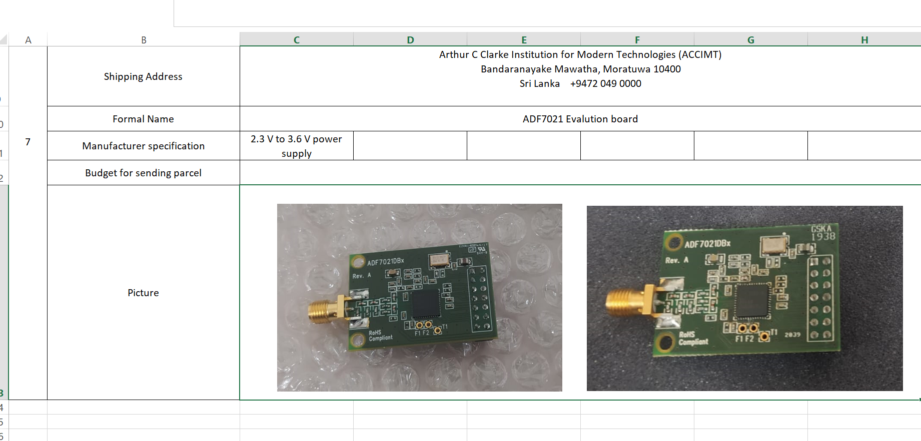
Sending Tharindu-san components
Excel file For Kawano-san

